Slide 1


IKAROS
THE SAVIOUR OF SEVEN LANDS

Slide 2

index
abstract
competitive analysis
synopsis
scoring
blind mode
pangeana
game play
characters
cuisine
weapons
festivals
game mechanics
empathy mapping
graphuse
user persona
user flow and information architecture
wireframes
game screen
brainstorming
references

Slide 3
abstract
In a world where cultures are being forgotten and the essence of festivals is fading, a mysterious force known as the chyronis rises to engulf the globe in eternal monotony. As traditions erode and celebrations dim, the vibrant tapestry of humanity begins to unravel, leaving the world on the brink of despair.
Amid this chaos, you, ikaros, an unlikely hero and a wanderer with an unquenchable curiosity for the world’s wonders, are chosen by fate to rise against this growing darkness. He was blessed with the wisdom of the goddess Athena, an ancient artifact of immense power You are tasked with rekindling the flames of cultural spirit. Guided by ancient power, Ikaros must locate the Guardians of Books, whose secret knowledge is essential for defeating the enemies of each zone. Together, they hold the key to restoring the festivals and unity that once bound humanity.
With every victory, the festival of that zone comes alive again, filling the world with music, dance, and traditions that symbolize the power of unity. These celebrations grow stronger with each win, reinvigorating Aarya and their team to face the ultimate challenge

Slide 4


competitive analysis
Monetization Model
Subscription-based with in-game purchases
World of Warcraft (WoW) is a massively multiplayer online role-playing game (MMORPG) developed by Blizzard Entertainment, set in the rich fantasy world of Azeroth. Players embark on epic quests, explore diverse landscapes, and engage in battles as they choose from various races and classes to shape their adventures.
TARGET AUDIENCE
Hardcore gamers, fantasy lovers
UNIQUE SELLING POINT
An immersive lore-driven fantasy world with multiplayer raids and progression systems
Gameplay Style
Open-world exploration, quest-driven progression, social multiplayer interactions

Slide 5

competitive analysis
Mario Kart is a beloved racing game series by Nintendo, featuring iconic characters from the Mario universe competing on whimsical tracks, using power-ups and items to outpace rivals in high-speed, chaotic fun.
TARGET AUDIENCE
All ages, casual gamers, Mario fans
GAMEPLAY STYLE
Competitive multiplayer races on imaginative tracks with item-based combat
UNIQUE SELLING POINT
Fast-paced races with quirky power-ups and iconic characters from the Mario series
Monetization Model
Pay-per-title; free-to-play mobile version with microtransactions

Slide 6

competitive analysis
Animal Crossing is a life-simulation game by Nintendo, where players create and manage their own idyllic village, interacting with anthropomorphic animal residents, customizing spaces, and enjoying a peaceful, open-ended world.
Monetization Model
Pay-per-title with optional in-game purchases in mobile version
Target Audience
Relaxation seekers, creative players
Gameplay Style
Non-linear, real-time gameplay focused on customization, socializing, and events
Unique Selling Point
Open-ended gameplay focusing on community building and creativity

Slide 7
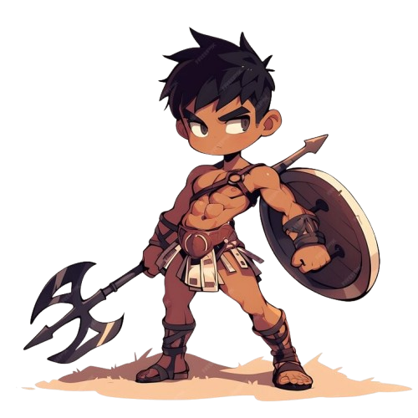


IKAROS
THE SAVIOUR OF SEVEN LANDS
continue
new game
online game
blind mode
options
quit game

Slide 8
Scoring
The hero, born in Greece, begins his journey by defeating the local commander and their army. With the commander's fall, the guardian of the Book of that region is freed, and the local festival is revived. He then progresses to the next region, repeating the process of battling commanders and liberating the guardians, restoring festivals along the way. Once all regional commanders are defeated, he faces the villain, with the guardians of the books aiding him in the final battle. During the fight, he can summon any of the freed guardians to aid in taking down the villain. If he dies while battling the commanders, the regions he has freed remain liberated. However, if he fails against the main villain, he must start his journey anew.

Slide 9

blind mode
Including a "Blind Mode" in our game could make it more accessible to people who are visually impaired or blind, offering a more inclusive experience.
1. Text-to-Speech (TTS)
2. Audio Cues for Navigation
3. Haptic Feedback
4. Voice Commands or Controller Support
5. Clear Audio Feedback for UI Elements

Slide 10

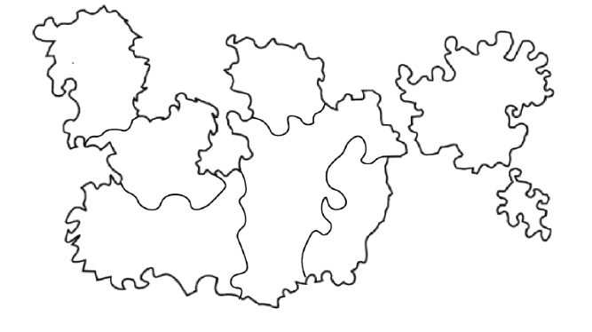


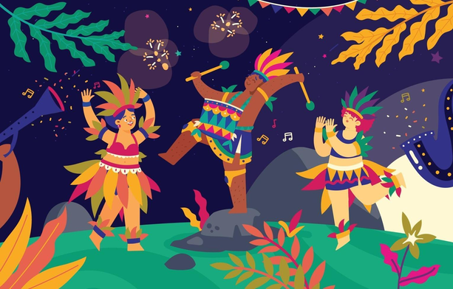

pangeana
Pindorama (Brazil)
brazil
Hispania (Spain)
Jambudweep (India)
Hellas (greece)
Zhongguo (China)
Wano (Japan)
A vibrant celebration of samba, costumes, and parades, the Rio Carnival is Brazil's iconic festival, showcasing its rich culture and electrifying energy. Free the city from evil commander of Chyronis.
Kemet (Egypt)
Kruvija (Kingdom of Chyronis)
Enter

Slide 11



explore lands
and cultures

Slide 12



complete the
dungeons

Slide 13
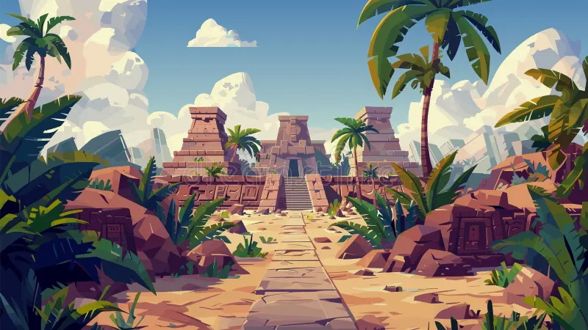
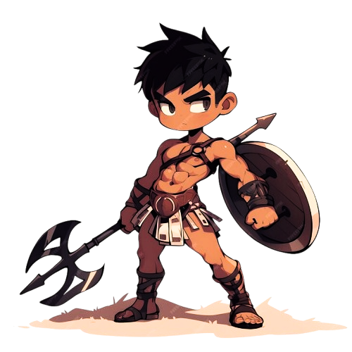
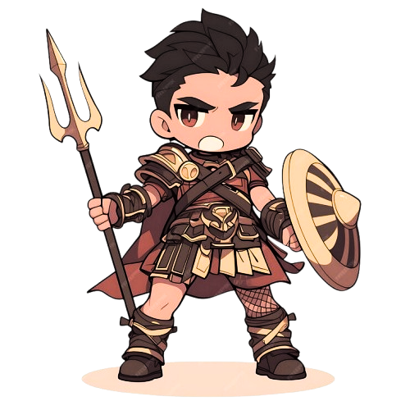
free the
warriors

Slide 14

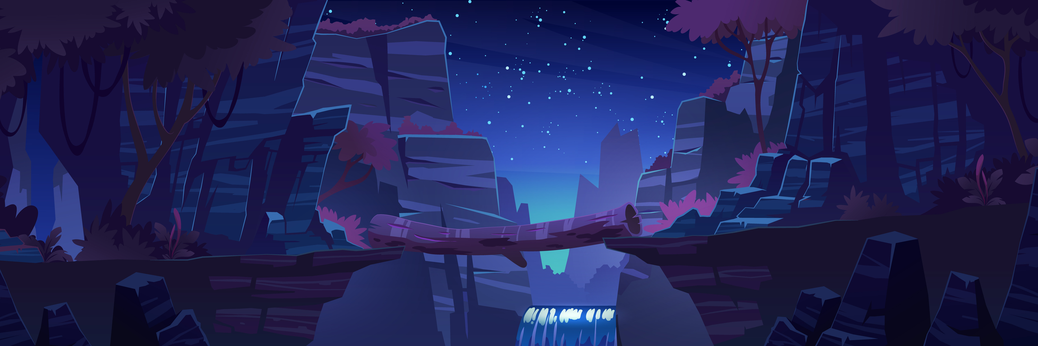

defeat
commanders

Slide 15

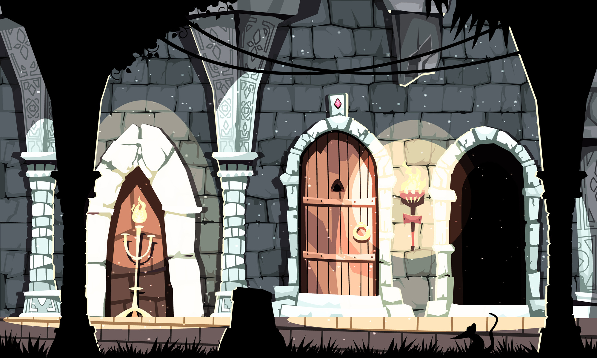





enjoy cuisines while completing dungeon
ATHENA
defeat malgroath and liberate people of spain
malgorath
huh ! you wish

Slide 16


liberate cities and
enjoy festival

Slide 17


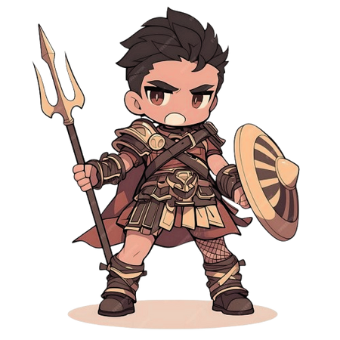

RYUUJIN
HEROES
ARCHADINO
IKAROS
ARACAYA
HEKRAION
athena
LONGWEI
RAGHUNATH NANDAN

Slide 18



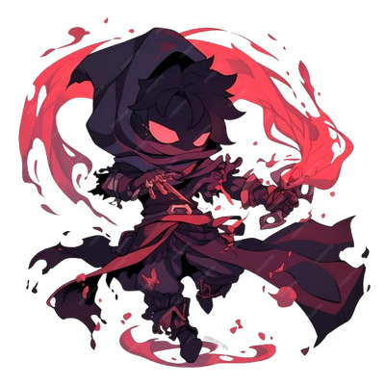



MALGORATH
VILLIANS
SERAPHINE
CHYRONIS
XYRIX
VALTHARION
ZHYRAXIS
ZEPHYRA
VALTHERIS

Slide 19

IKAROS
the hero of the game, wields a massive axe as he journeys through perilous dungeons to defeat powerful villains. Guided by Athena, his guardian angel, Ikaros battles fierce enemies and frees the Guardians of the Books, ancient protectors with the power to help him confront Chyronis, the dark force threatening the world. With each Guardian freed, Ikaros grows stronger, combining his martial prowess and Athena's wisdom to defeat Chyronis in the ultimate battle, restoring peace and balance to the realms.
CHYRONIS
the dark ruler of Kruvija, has silenced festivals across the world to erase divine influence and plunge humanity into despair. His seven commanders enforce his oppressive rule, ensuring no joy or celebration thrives. From his cold, shadowy fortress, Chyronis seeks to create a world of eternal darkness. If defeated, his reign will crumble, and the world will burst into light, joy, and celebrations, restoring hope and divine harmony.

Slide 20
MALGORATH
The Seven Commanders of Chyronis
The Seven Commanders of Chyronis are his loyal enforcers, each ruling over a region of the world to suppress festivals and ensure darkness prevails. They have also captured the Guardians of the Books, ancient protectors holding the knowledge and power needed to restore balance. Each commander embodies a unique aspect of fear and oppression, using their powers to maintain Chyronis’ rule.
VALTHARION
ZEPHYRA
SERAPHINE
XYRIX
ZHYRAXIS
VALTHERIS

Slide 21
RYUUJIN
Seven protectors of the books
The Guardians of the Books are ancient protectors, each holding the power and wisdom of a sacred tome that can restore balance to the world. Imprisoned by Chyronis' six commanders, they await their release to help Ikaros in his quest to bring light and joy back to the realms. Each Guardian represents a virtue tied to their book, vital for overcoming the darkness.
HEKRAION
ARACAYA
ARCHADINO
RAGHUNATH NANDAN
LONGWEI

Slide 22
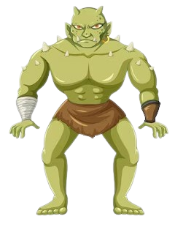
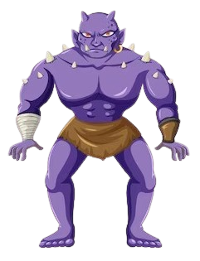
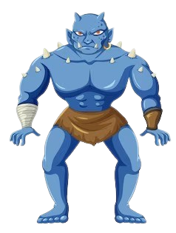
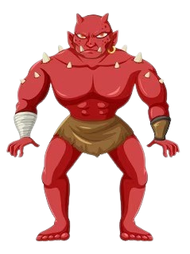
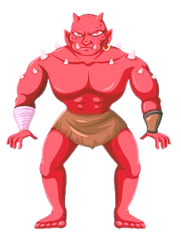
Army of Chyronis
The Army of Chyronis is a relentless legion of darkness, formed from twisted souls and monstrous creatures. United under Chyronis' will, they are tireless enforcers of his rule, spreading fear and chaos across the world. These ruthless warriors will stop at nothing to prevent Ikaros from freeing the Guardians and restoring light to the realms.

Slide 23


cuisines
Koshary (also spelled Kushari or Koshari) is a traditional Egyptian dish that combines pasta, rice, lentils, chickpeas, and is topped with fried onions and a tangy tomato sauce.
koshary
Paella is a famous Spanish dish that originates from the region of Valencia, located on the eastern coast of Spain. It's a hearty, flavorful one-pan dish typically made with rice, saffron, and a combination of seafood, meat, and vegetables.
paella
Feijoada is a traditional Brazilian stew made primarily of black beans and a variety of meats.
feijoda
Ramen is a popular Japanese noodle soup dish that has become a global culinary sensation. It consists of Chinese-style wheat noodles served in a flavorful broth, typically garnished with various ingredients such as sliced meats, vegetables, eggs, and condiments.
ramen

Slide 24

cuisines
Greek Salad (or Horiatiki in Greek) is a traditional dish from Greece, known for its fresh, vibrant ingredients and simple yet bold flavors. It's a refreshing combination of vegetables, cheese, olives, and dressing, making it a popular choice for warm weather or as a side dish to accompany various Mediterranean meals.
greek salad
Sushi is a traditional Japanese dish that has become popular worldwide, known for its combination of vinegared rice, seafood, vegetables, and sometimes nori (seaweed). It is often served with soy sauce, wasabi, and pickled ginger
sushi
Chole Bhature is a popular North Indian dish that is both flavorful and indulgent. It consists of chole (spicy chickpea curry) served with bhature, which are deep-fried bread made from a dough of flour, yogurt, and baking soda or yeast.
chole bhature

Slide 25





WEAPONS
athenian blade
·Base Damage: 150
·Divine Slash (Special Attack): 300
Effect: Deals massive single-target damage and stuns the enemy for 2 seconds
Shield of Light
Shield of Light · Base Damage: 0 (Used primarily for defense) · Reflective Barrier (Special Attack): Reflects 50% of incoming damage back at the attacker, up to 100 damage. o Effect: Reduces damage taken by Ikaros by 30% for 5 seconds, and reflects up to 100 damage to enemies attacking him.
Thunderstrike
Description: Ikaros calls down the power of the heavens, summoning a powerful lightning strike to hit all nearby enemies.
· Effect: Deals 200 lightning damage to all enemies within a radius of 5 meters. Has a chance to stun enemies for 1 second.
· Cooldown: 15 seconds.

Slide 26




festivals
Diwali
Diwali, also known as the Festival of Lights, is one of the most significant Hindu festivals, celebrated with great enthusiasm across India and beyond.
Guo Nian
Chinese New Year, or "Guo Nian", is the most significant traditional festival in China, marking the Lunar New Year and the arrival of spring. Spanning 15 days
Epidaurus
The Athens Epidaurus Festival, founded in 1955, is one of Greece's most prestigious cultural events, held annually in summer. It celebrates Greece’s artistic heritage and features modern interpretations of classical works.
Tomatina
La Tomatina is a Spanish festival in Buñol, Spain where participants throw tomatoes at each other. It is said to be the biggest food fight in the world

Slide 27
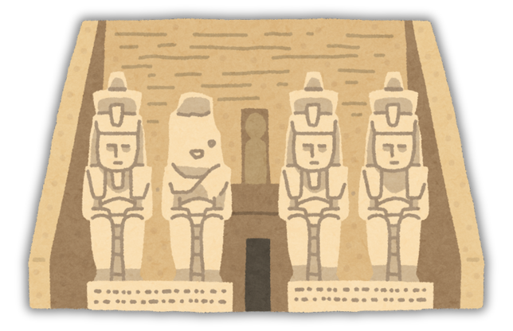



Abu Simbel Sun Festival
The Abu Simbel Sun Festival, held on February 22 and October 22, celebrates Ramses II, with the sun aligning to illuminate his statues at the Abu Simbel Temples, highlighting ancient Egyptian engineering and culture.
The Rio Carnival
The Rio Carnival in Brazil is the world’s largest and most vibrant carnival, held annually before Lent, marking a grand celebration of music, dance, and culture.
Gion Matsuri
Gion Matsuri is one of Japan's most famous traditional festivals, held annually in Kyoto throughout July. Originating in the 9th century as a purification ritual to appease the gods during a plague

Slide 28
Game Mechanics
Walking : Ikaros moves at a steady pace, observing the surroundings and preparing for upcoming challenges.
Running : Ikaros sprints with determination, closing the distance between him and his enemies or objectives quickly.
Single Attack : A swift, precise strike with Ikaros' weapon, designed to deal moderate damage to enemies in his path, with movement.
Healing : There are potions those spawn in dungeons which when the player uses, gains health.
Divine Attack : A powerful, god-infused strike, channeling celestial energy to deal massive damage and overwhelm foes, with movement at 50-100 pixels/sec depending on the attack.
Block : Ikaros raises his shield or weapon, deflecting incoming attacks and minimizing damage with solid defense, usually stationary, or repositioning at 50-80 pixels/sec

Slide 29
Empathy mapping of a gamer
Says
Thinks
Will this game keep me engaged long enough, or will I get boredIt’s so annoying when a game forces me to watch ads.
I hope the rewards in this game feel worth my time.
Do I need to spend money to stay competitive in this game
This game could help me unwind after a stressful day.
I want a game that’s fun but also challenging
It’s so annoying when a game forces me to watch ads.
I love games where I can explore new worlds and stories
Multiplayer games are great because I can play with my friends
Feels
Does
Helps unwind after a stressful day
Skip ads or avoid games with frequent paywalls.
Share achievements or screenshots on social media.
Search for walkthroughs, tips, or guides to progress faster.
Excited when unlocking new levels, achievements, or content.
Frustrated when stuck on a difficult level or experiencing glitches.
Proud after completing a challenging puzzle or defeating opponents.
Relaxed and happy when the game provides a fun escape from reality.

Slide 30
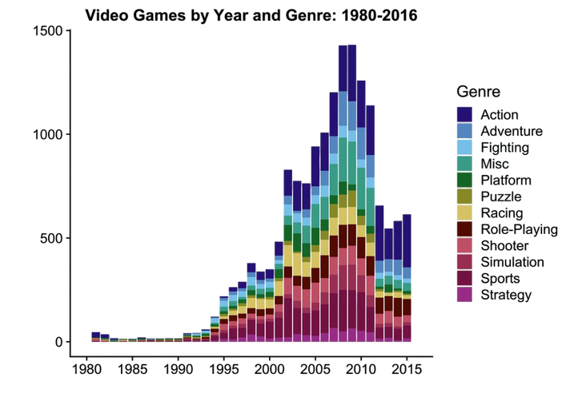
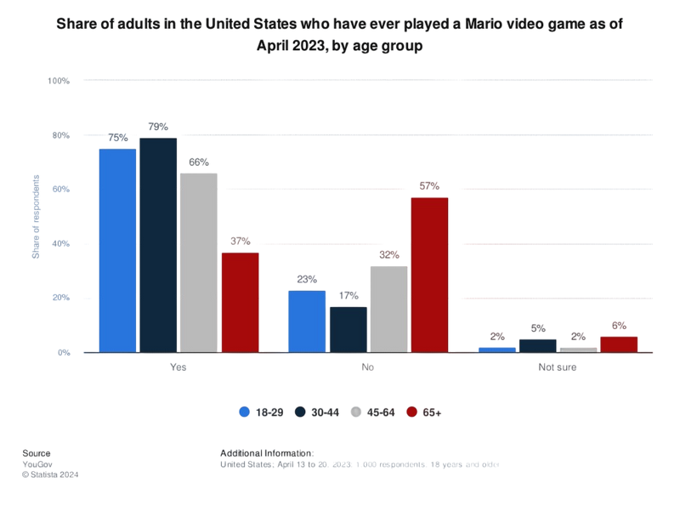
genre graph for platform and puzzle games
Teens (Ages 13-17)
Appeal: Platformer games for teens often offer more complex mechanics and challenging levels. This age group might enjoy platformers with a bit more depth or a more mature theme, such as faster gameplay, intricate world-building, or puzzles that require more skill and strategic thinking.
Examples: Celeste, Shovel Knight, Rayman Legends.
Gameplay Features: More intricate designs, difficulty spikes, deeper narratives, and more dynamic platforming mechanics to keep teens engaged.
Young Adults (Ages 18-30)
Appeal: Young adults are attracted to both nostalgic platformers from their childhood and more innovative, challenging platformers with unique art styles, storylines, and innovative mechanics. Many of these players appreciate retro-style platformers as well as modern indie games that push boundaries.
Examples: Hollow Knight, Cuphead, Super Meat Boy.
Gameplay Features: High difficulty, competitive leaderboards, stylized visuals, and more sophisticated narratives or themes.

Slide 31

user persona - age group 12 - 18
Bio
Goals
Compete in online tournaments and gain recognition in gaming communities.
Unlock new skins, characters, or weapons through gameplay, not by paying.
Find games that balance action and a strong storyline to stay engaged long-term.
Name: James Kumar
Age: 16 years
Location: Chicago, USA
Occupation: High School Student
Pain Points
Gets frustrated when games are too slow to load or have constant freezes.
Doesn’t like games that are too easy, prefers a challenge.
Dislikes games with too many ads or microtransactions that affect gameplay.
Motivation
Enjoys action-packed, multiplayer games where he can compete with friends.
Loves customizing characters, collecting rewards, and leveling up.
Interested in story-driven games that have a strong narrative with plot twists.

Slide 32

user persona - age group 19 - 25
Bio
Goals
Find games that can be played both solo and with friends, to balance relaxation and social interaction.
Explore new genres, especially games with a strong narrative and emotional impact.
Play games that have regular updates and are continuously evolving with the community
Name: Sofia Martinez
Age: 22 years
Location: Madrid, Spain
Occupation: University Student (Psychology)
Pain Points
Frustrated by games that lack meaningful progression or have poor reward systems.
Doesn’t like games with overwhelming ads or intrusive pop-ups.
Tired of games that are too repetitive and don’t evolve with updates.
Motivation
Enjoys immersive games with detailed worlds and engaging characters.
Prefers games that offer deep customization and personalization options.
Seeks games that provide both a challenge and a way to relax after studies.

Slide 33
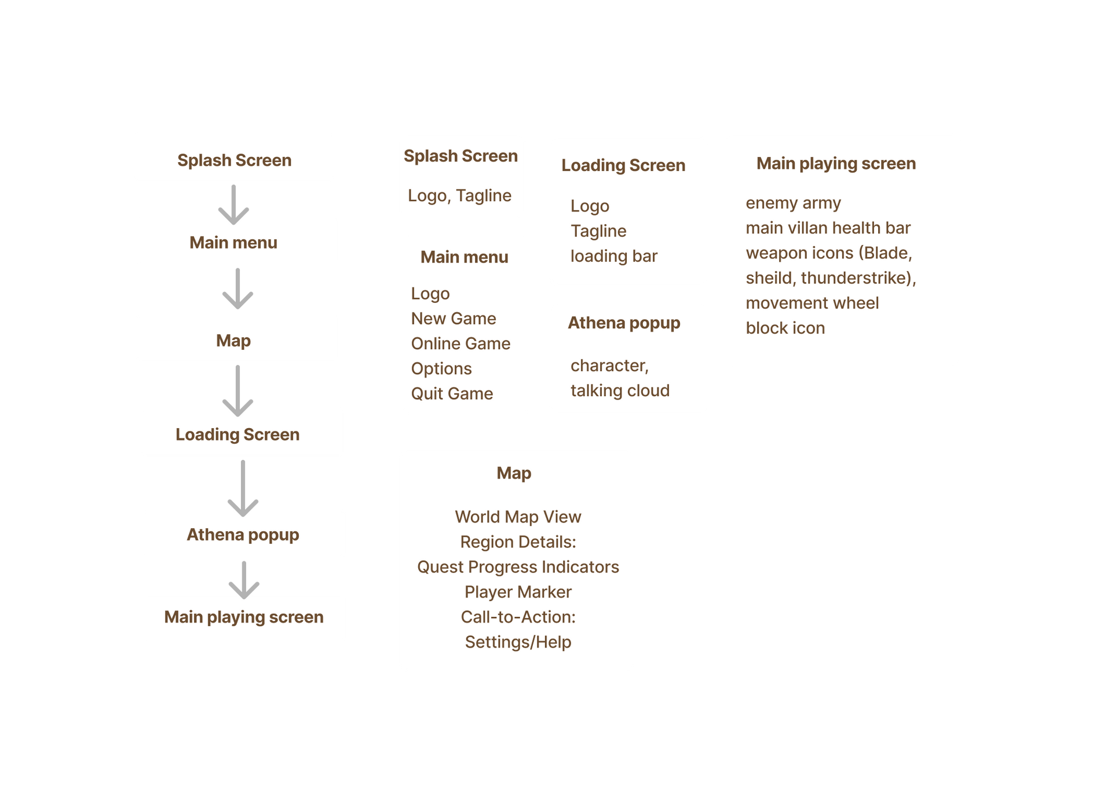
User Flow and Information Architecture

Slide 34


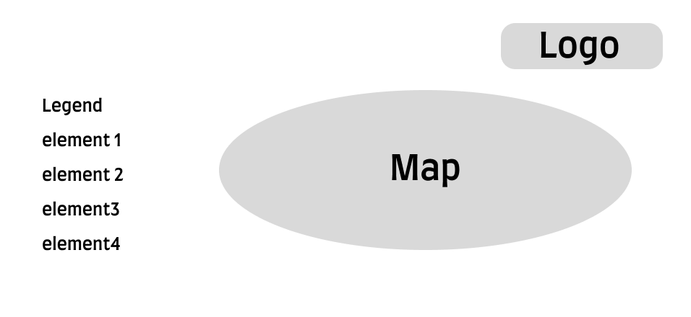

Wireframes
Splash screen
Main Menu screen
Information Screen
Map Screen

Slide 35

Main game screen
Health Bar
Movement
Joystick
Attacks
Hero
Villian

Slide 36
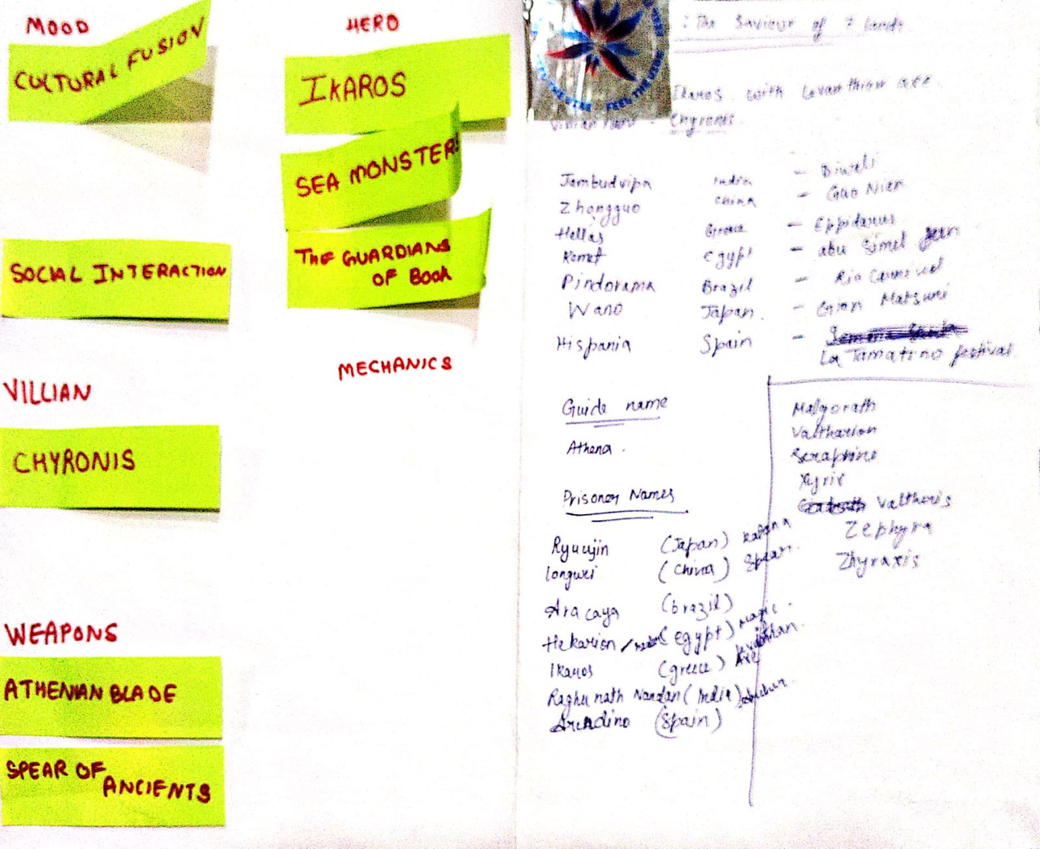
Brainstorming Session

Slide 37
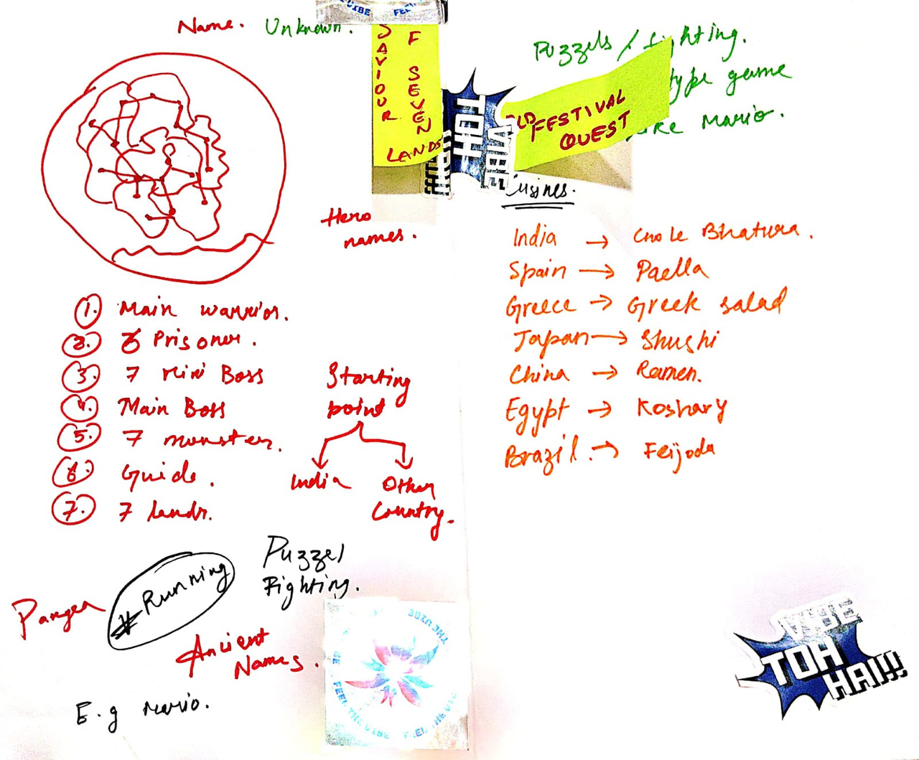
Brainstorming Session

Slide 38
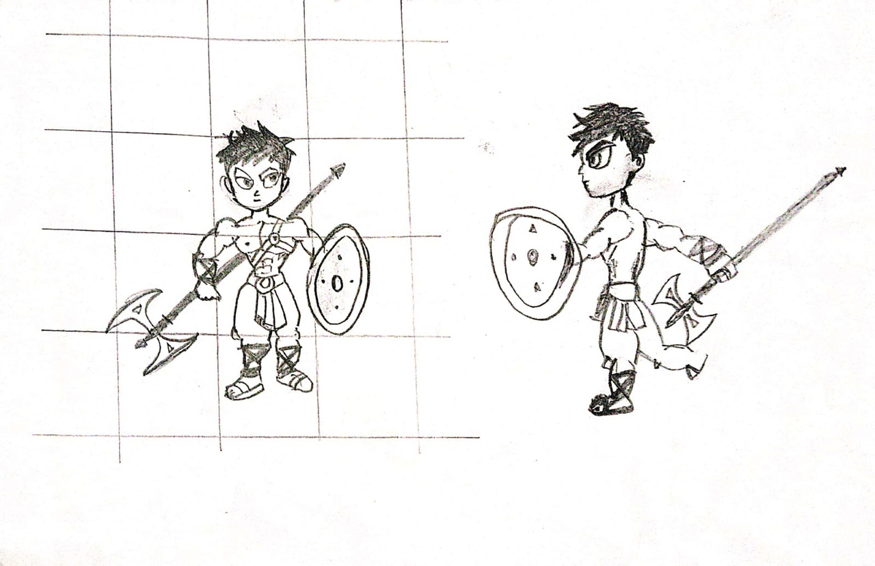
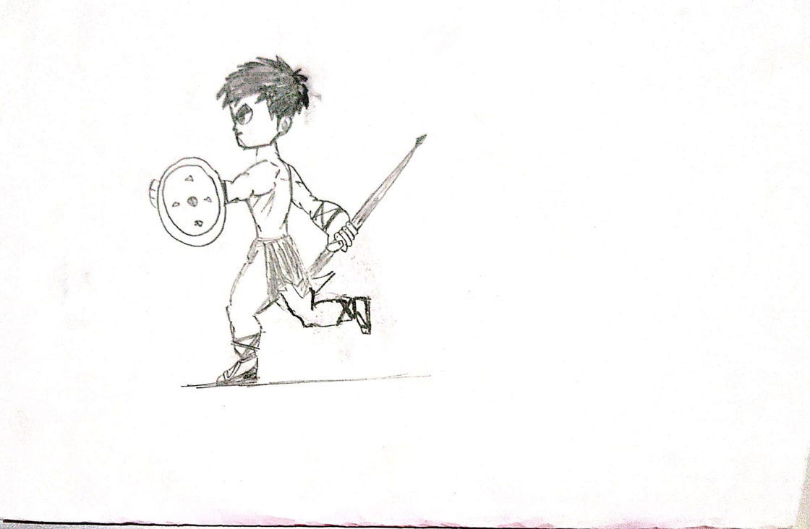
Brainstorming Session

Slide 39
Links and References
https://fr.pinterest.com/pin/851672979553394463
https://www.freepik.com/free-photo/portrait-beautiful-young-woman-standing-grey-wall_13813927.htm#fromView=search&page=1&position=16&uuid=e7ebbcf4-b447-4613-921b-77a223838c43
https://www.freepik.com/free-photo/stylish-young-handsome-traveler-man-standing-looking-camera_4930019.htm#fromView=search&page=4&position=52&uuid=cfa03e8c-13c9-4f26-a2f8-6b23989a38c9
https://www.freepik.com/free-vector/hand-drawn-greek-mythology-illustration_25793988.htm#fromView=search&page=2&position=4&uuid=7ec41ba7-f79d-4cab-95be-201afefb9496
https://www.freepik.com/free-vector/ancient-building-ruins-with-broken-ionic-marble-pillars-climbing-plants-realistic-vector-illustration_132324839.htm#fromView=search&page=2&position=26&uuid=80162167-500b-4f0c-b3c6-9e688bfefcea
https://www.fhttps://img.freepik.com/premium-vector/old-antique-treasure-map-cartoon-island-map-template-level-game-adventures-quest-treasure-hunt-pirate-grunge-map-hand-drawn-vintage-vector-illustration_87946-5196.jpgreepik.com/free-vector/vintage-paper-background-with-watercolor-effect_877563.htm#fromView=search&page=1&position=0&uuid=8106241c-ba40-4684-b12d-6b2cfa5deedc
https://www.freepik.com/free-vector/set-troll-cartoon-character_43102503.htm#fromView=image_search_similar&page=1&position=4&uuid=dd6441c1-9594-4393-a717-cb30bda5cb15
https://www.freepik.com/free-vector/set-troll-cartoon-character_39208073.htm#fromView=image_search_similar&page=1&position=36&uuid=84c865d8-1fb0-4d75-8594-770637c32fbd

Slide 40
thank you

